Slide 1
Health Policy 101
How do you get involved?
Devin Delrow, Director of Federal Relations, NIHB

Slide 2
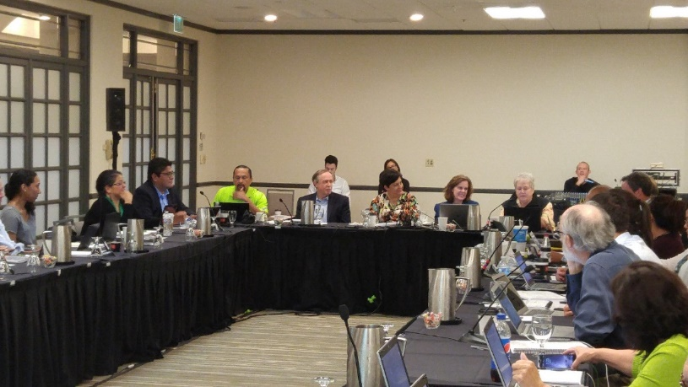
Medicare, Medicaid, and Health Care Reform Policy Committee (MMPC)
Standing Committee
Open Membership
Meets regularly
Welcomes new additions
Growing
Notes:
On August 26 and 27, I attended the Direct Service Tribes National Meeting in Flagstaff, AZ. I provided an NIHB update during the plenary session where I informed the audience about all the activities and work that NIHB is engaged in. I also worked with our Tribal Health Reform team at the exhibiting booth, greeting constituents and consumers as they asked for more information about the Affordable Care Act.

Slide 3
How we communicate?
Subcommittees
E-Mail Listservs!
  Notices/Updates
  Newsletters
Teleconferences
Face-to-Face Meetings

Slide 4
Tools Available
Can be found on NIHB website:
http://www.nihb.org/tribalhealthreform/mmpc/

Slide 5
What’s next?
Ask your Tribe
  Volunteer
  Find a Mentor
Ask your Area Health Board
Internships at the National Indian Health Board
Become a Technical advisor
Stay Informed
  READ!

Slide 6
Thanks!
Please see me if you want to become involved with NIHB’s MMPC

